Slide 1



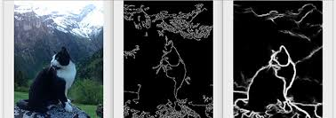
Session 4 :
Introduction to Edge Detection

Slide 2
Introduction
Edge detection highlights the boundaries of objects in images.
Vital in fields such as robotics, medical imaging, and computer vision.

Slide 3
Learning Outcome
Use algorithms like Sobel and Canny to detect object boundaries.
Understand edge characteristics and gradient detection.

Slide 4
Programming Task Overview
Write a script using OpenCV’s cv2.Canny to detect edges.
Visualize edge maps and learn how to adjust detection thresholds.

Slide 5
Why It Matters
Edge detection helps recognize shapes and structures.
Applications:
- Self-driving cars: Lane detection
- Barcode scanning
- Face recognition prep

Slide 6
Real-World Example
Scenario 1: Detecting road lanes in autonomous vehicle systems.
Scenario 2: Recognizing barcodes on products in inventory management.

Slide 7
Exploring Edge Detection Algorithms
Sobel: Detects gradient changes in x and y directions.
Canny: More advanced; uses gradient, non-maximum suppression, and hysteresis.

Slide 8
Implementing Canny Edge Detection
Use: cv2.Canny(image, threshold1, threshold2)
Allows control over edge sensitivity and noise filtering.

Slide 9
Overlaying Edges on Original Image
Use: cv2.addWeighted(original, alpha, edges, beta, gamma)
Helps visualize where edges occur within the context of the original image.

Slide 10
Preprocessing for Better Edges
Apply Gaussian blur before edge detection to smooth noise.
Improves edge clarity and reduces false positives.

Slide 11
Tuning Canny Parameters
Experiment with low/high threshold values to suit different image types.
Fine-tuning yields more accurate and useful edge maps.

Slide 12
Python Code:
Edge Detection
📝 Project Title: Interactive Edge Detection with Parameter Tuning
🎯 Objective:
Detect edges using the Canny algorithm with real-time threshold tuning and optional noise reduction.
📚 Key Topics:
- Canny Edge Detection
- Real-time parameter control with OpenCV trackbars
- Edge visualization and refinement

Slide 13
Image Preprocessing & Trackbar Setup
🔹 Image Preprocessing:
- Load grayscale image using cv2.imread()
- Apply Gaussian blur (5x5) with cv2.GaussianBlur to reduce noise
🔹 Trackbar Integration:
- Create OpenCV window with cv2.namedWindow
- Add trackbars for Low and High thresholds using cv2.createTrackbar

Slide 14
Edge Detection & Refinement
🔍 Canny Edge Detection:
- Retrieve threshold values from trackbars
- Apply cv2.Canny with low and high thresholds
- Ensure low < high to prevent errors
🖌️ Edge Refinement:
- Use cv2.dilate (3x3) to thicken edges for clarity

Slide 15
Python Script - Code Summary
Main Functions Used:
- cv2.imread, cv2.GaussianBlur, cv2.Canny, cv2.dilate
- cv2.namedWindow, cv2.createTrackbar, cv2.getTrackbarPos
- cv2.hconcat, cv2.imshow, cv2.waitKey, cv2.destroyAllWindows
💡 Tip: Trackbars offer intuitive control for exploring image parameters interactively!

Slide 16
Real-Time Display & Interaction
🖼️ Display Logic:
- Concatenate original and edge images using cv2.hconcat
- Display them side-by-side in a loop using cv2.imshow
⌨️ User Interaction:
- Thresholds adjust dynamically via trackbars
- Exit on pressing 'q' using cv2.waitKey

Slide 17

Python Script on Edge Detection
PART 1
import cv2
import numpy as np
def nothing(x):
pass
image = cv2.imread('image.jpg', cv2.IMREAD_GRAYSCALE)
if image is None:
raise ValueError("Image not found!")
blurred = cv2.GaussianBlur(image, (5, 5), 0)

Slide 18
Python Script on Edge Detection
PART 2
cv2.namedWindow('Canny Edges')
cv2.createTrackbar('Low Thresh', 'Canny Edges', 100, 255, nothing)
cv2.createTrackbar('High Thresh', 'Canny Edges', 200, 255, nothing)

Slide 19
Python Script on Edge Detection
PART 3
while True:
low = cv2.getTrackbarPos('Low Thresh', 'Canny Edges')
high = cv2.getTrackbarPos('High Thresh', 'Canny Edges')
if low >= high:
high = low + 1
edges = cv2.Canny(blurred, low, high)
edges = cv2.dilate(edges, np.ones((3,3), np.uint8), iterations=1)
combined = cv2.hconcat([image, edges])
cv2.imshow('Canny Edges', combined)
if cv2.waitKey(1) & 0xFF == ord('q'):
break
cv2.destroyAllWindows()

Slide 20
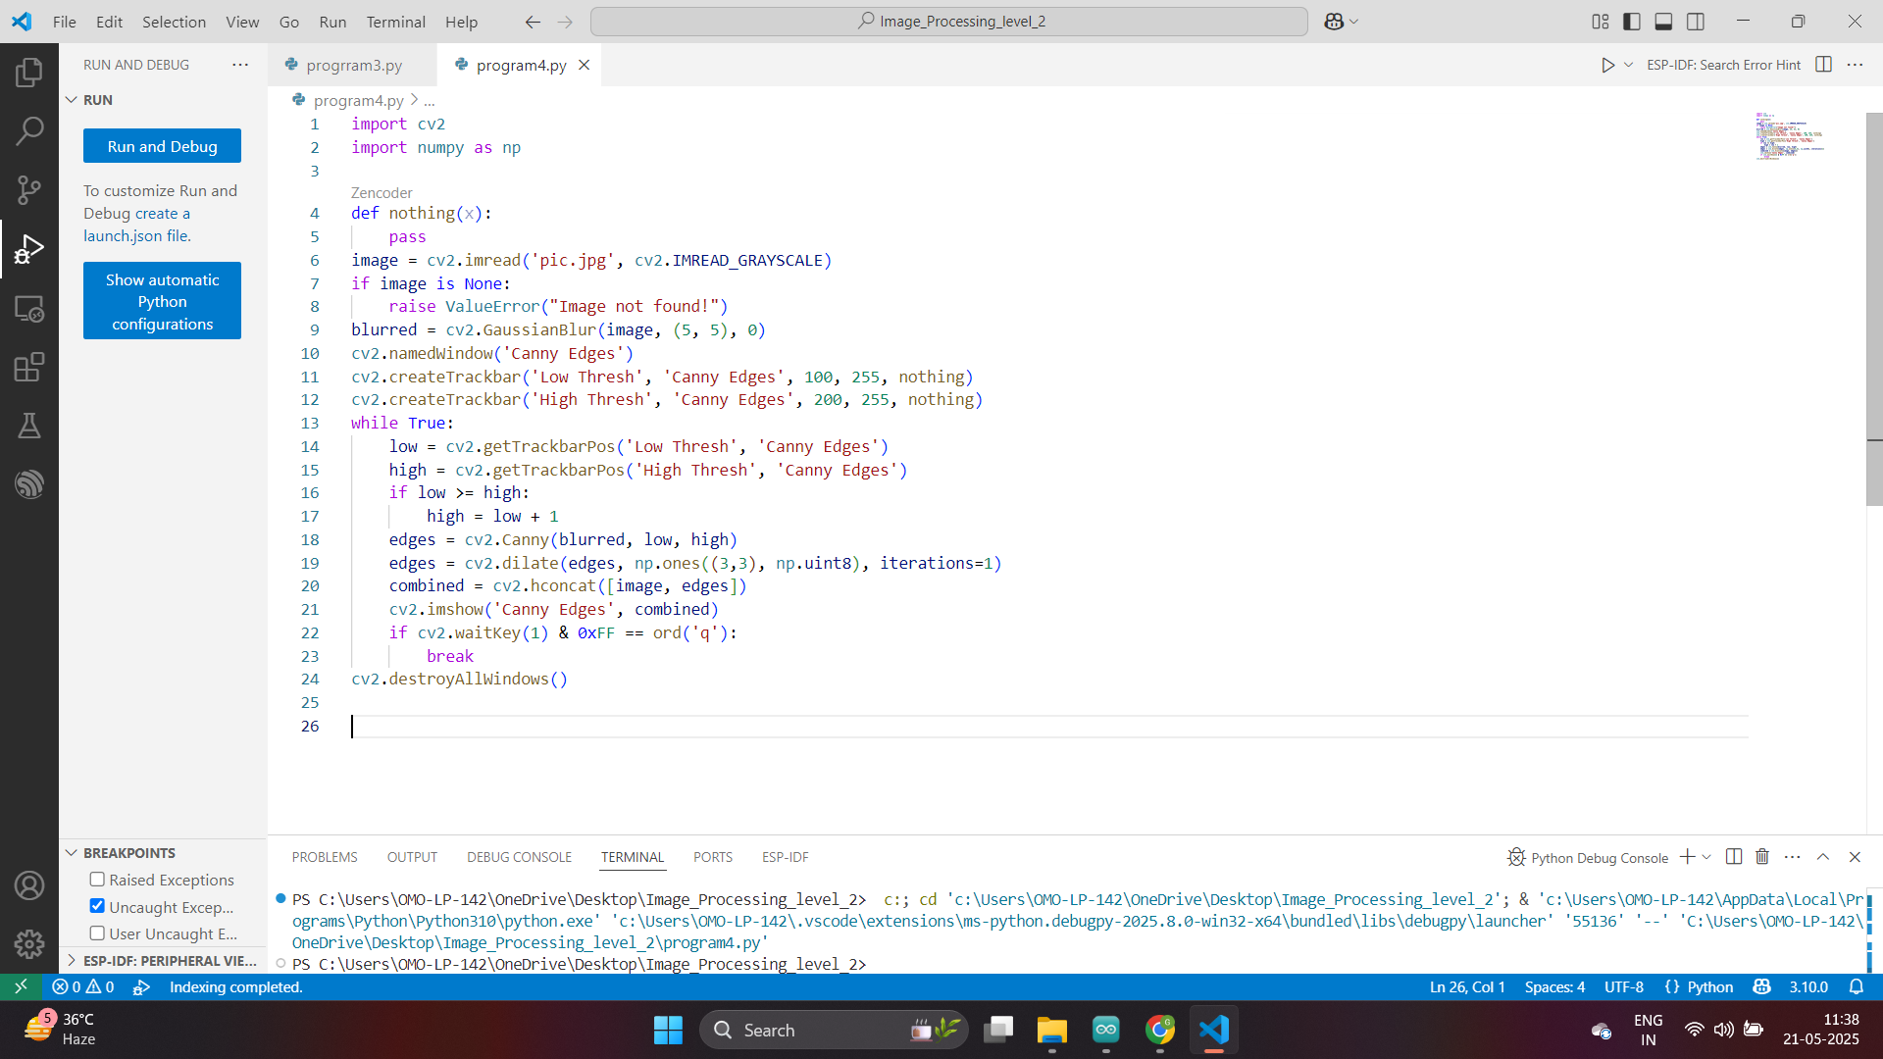

Slide 21
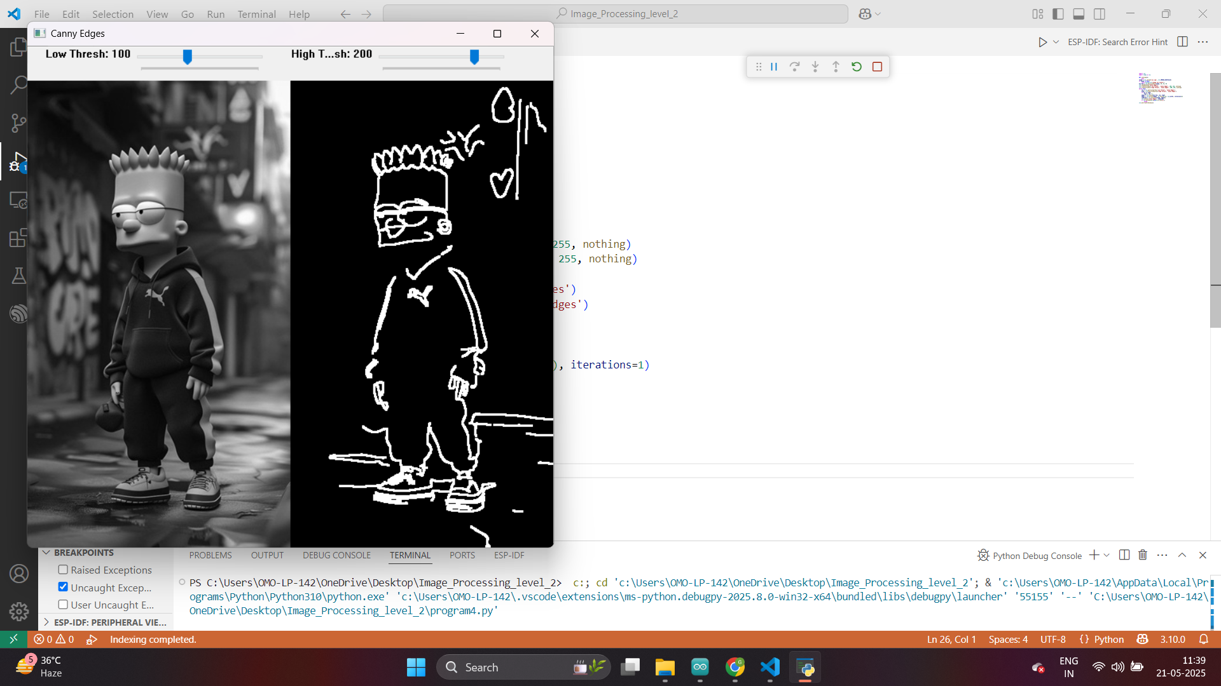

Slide 22
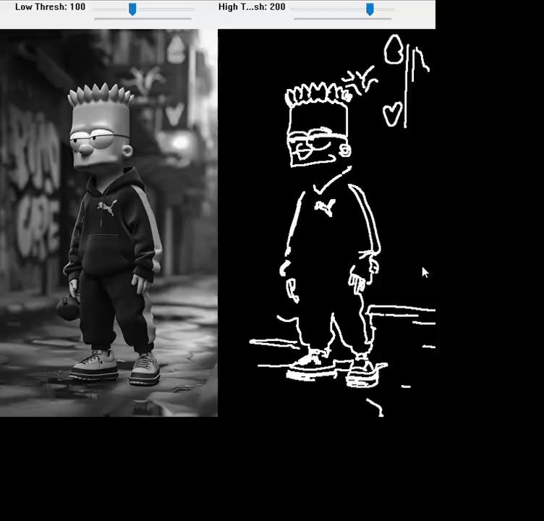
Python Script
Results
Video
Detailing
Various
Scenarios

Slide 23

Exercise
1. What is the primary goal of edge detection in image processing?
A. Enhance colors
B. Remove noise
C. Highlight object boundaries
D. Compress the image
Answer: C
2. Which algorithm uses gradient, non-maximum suppression, and hysteresis thresholding?
A. Laplacian
B. Sobel
C. Prewitt
D. Canny
Answer: D

Slide 24
Exercise
3. What does the function cv2.Canny(image, threshold1, threshold2) return?
A. A binary image with edges detected
B. The image histogram
C. An image with contours
D. A 3D color model
Answer: A
4. Why is Gaussian blur applied before edge detection?
A. To increase contrast
B. To sharpen the image
C. To reduce noise and false edges
D. To change color channels
Answer: C

Slide 25
Exercise
5. Which OpenCV function is used to combine original and edge images side-by-side?
A. cv2.merge
B. cv2.add
C. cv2.concat
D. cv2.hconcat
Answer: D
6. In Canny edge detection, what does a high threshold do?
A. Ignores weak edges
B. Blurs the image
C. Identifies only strong edges
D. Highlights all regions
Answer: C

Slide 26
Exercise
7. What is the use of cv2.dilate() in edge detection?
A. Reduces image resolution
B. Sharpens the edges
C. Thins the edges
D. Thickens the edges
Answer: D
8. What kind of image is typically used for edge detection?
A. RGB color image
B. Thermal image
C. Grayscale image
D. Histogram image
Answer: C

Slide 27
Exercise
9. What OpenCV feature allows real-time adjustment of edge detection thresholds?
A. cv2.setMouseCallback
B. cv2.createTrackbar
C. cv2.VideoCapture
D. cv2.addWeighted
Answer: B
10. What is the purpose of cv2.addWeighted() in edge visualization?
A. It filters high frequencies
B. It blends edge and original images for better context
C. It increases threshold sensitivity
D. It reduces blur
Answer: B

